Slide 1

Team 30
RESTAURANT MANAGEMENT
SYSTEM
To simplify your restaurant’s workflow

Slide 2
TABLE OF CONTENTS
01
02
03
INTRODUCTION
PROJECT DESCRIPTION
PROJECT VISION &
HIGH-LEVEL REQUIREMENT
04
05
PROJECT PLAN
PRODUCT & SPRINT BACKLOG

Slide 3

01
INTRODUCTION

Slide 4

02
PROJECT
DESCRIPTION

Slide 5
Where does this idea come from?
One of our team members came up with this idea during the time he was working at a local restaurant.
2. How can this system help restaurants to deal with their management tasks
We understand how stressful it is for the restaurant managements to deal with their daily tasks. Both human and food resources in restaurants need to be managed by manager in order to create good benefits for their businesses.
Therefore, we create a system that mainly focuses on management tasks such as:
inventory compilation
staff scheduling
staff payment
restaurant profit visualization
In order to assist managers in managing resources and being able to pay more attention to develop their business

Slide 6
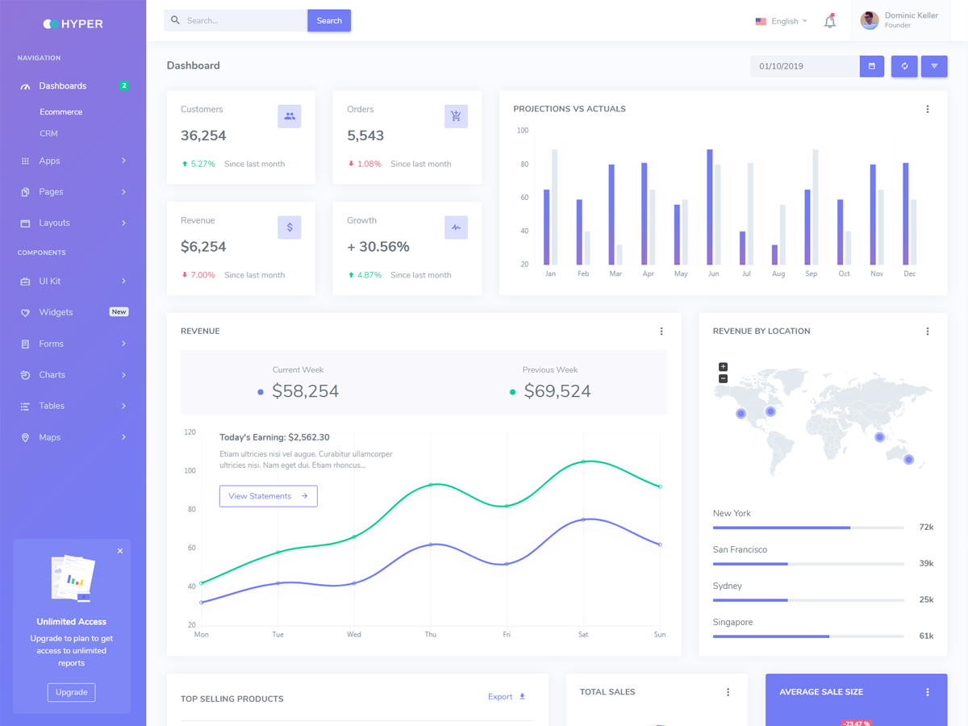

Slide 7
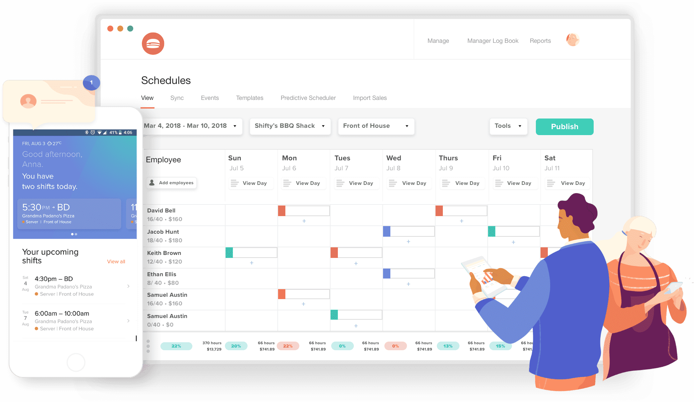

Slide 8

03
PROJECT VISION &
HIGH-LEVEL REQUIREMENT

Slide 9
PROJECT VISION
MANAGEMENTS
OUR VISION
FRONT-OF-HOUSE STAFFS
BACK-OF-HOUSE STAFFS
Restaurant Dashboard that helps managers visualizing profits, both human and other resources
Our vision is to simplify restaurant managements’ daily tasks, and to increase restaurant employees’ productivity
Helps FOH staffs to handle order more efficiently, and to track their schedule easily
Assists BOH staffs to compile inventory, to handle orders efficiently and to track their schedule comfortably

Slide 10
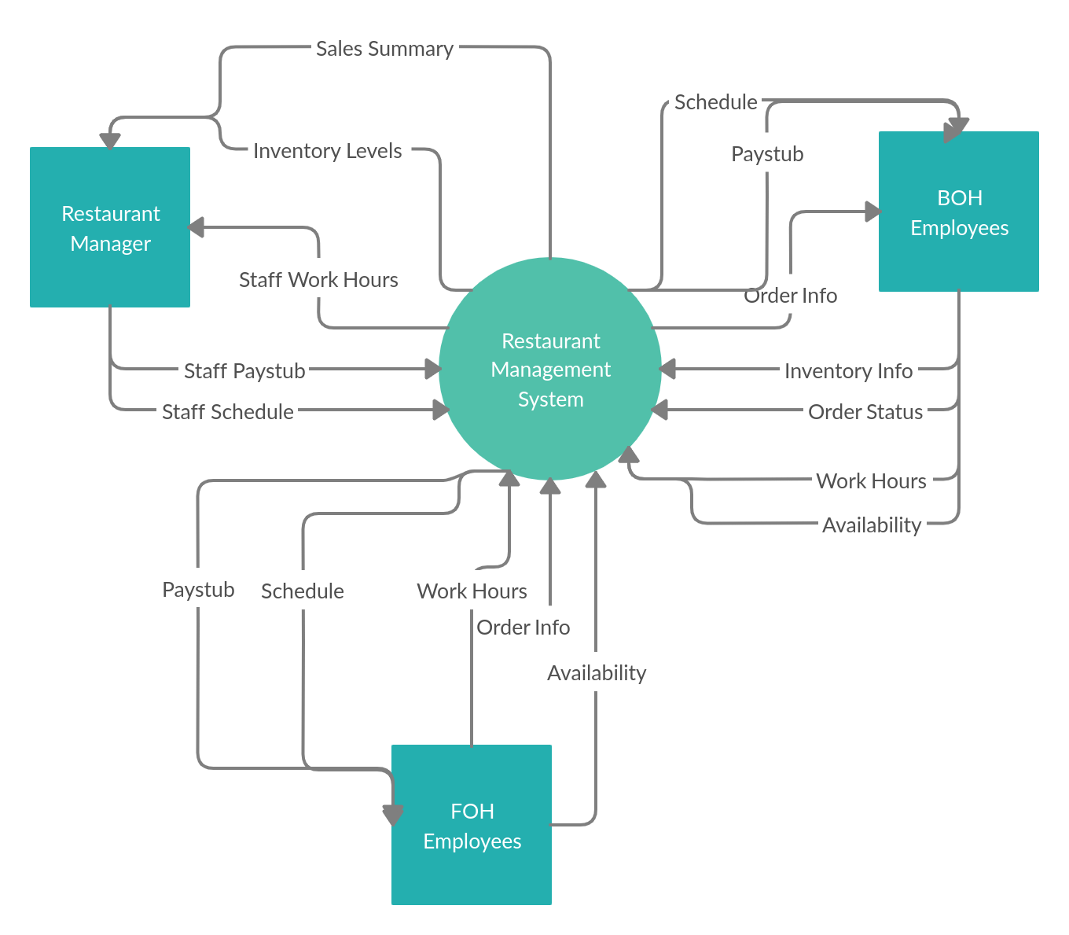
BUSINESS CONTEXT DIAGRAM

Slide 11

04
PROJECT PLAN

Slide 12
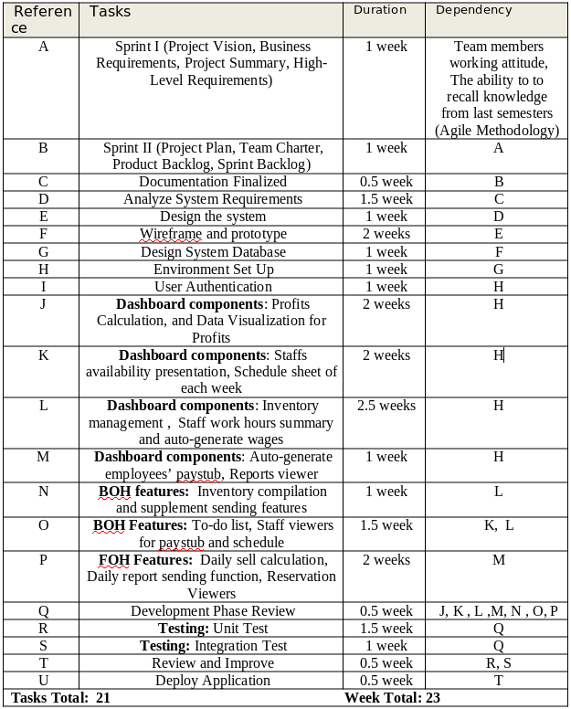
Task Listing

Slide 13
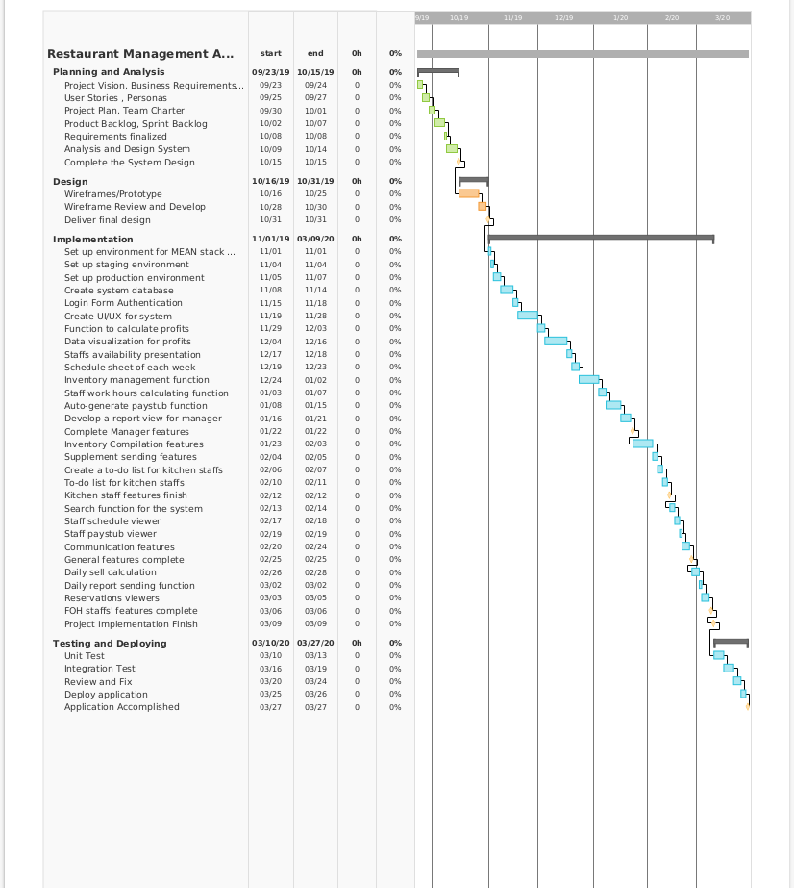
Gantt Chart

Slide 14
PROJECT PLAN MILESTONES
Deliver final design
(Wireframe)
Complete staffs features (FOH and BOH staffs)
Release the application
31
06
27
OCTOBER
MARCH
MARCH
22
25
JANUARY
MARCH
Complete restaurant management features
Finish testing and get the application production ready

Slide 15

RISK MANAGEMENT
DEPENDENCIES

Slide 16
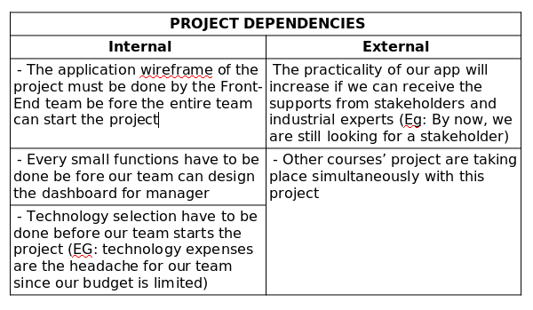

Slide 17
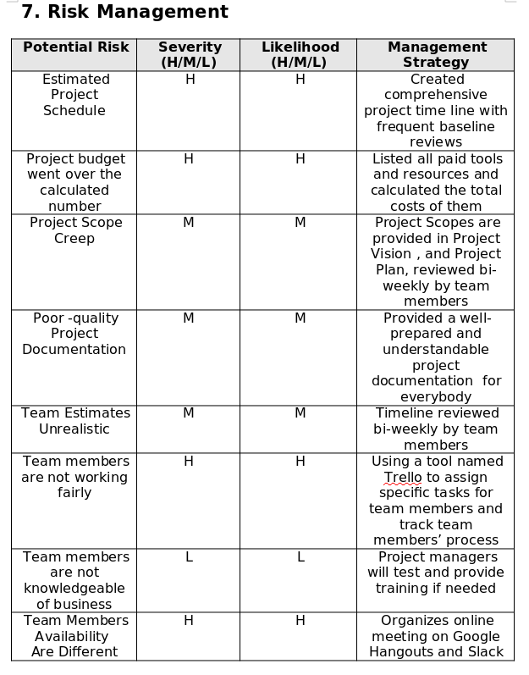

Slide 18

05
TEAM CHARTER
PRODUCT + SPRINT BACKLOG

Slide 19
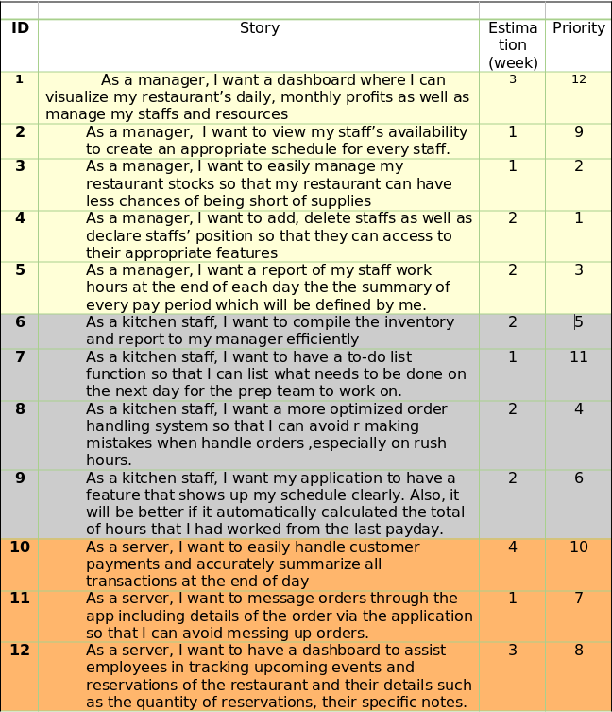

Slide 20
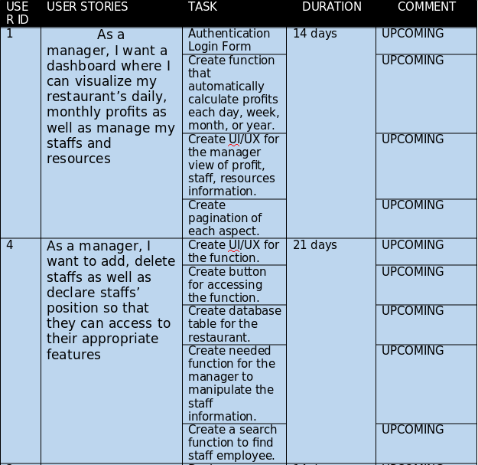

Slide 21
Team Composition
Our team is divided into 3 small teams:
Front-End Team: Thanh Quan, Quang Pham
Back-End Team: Tu Nguyen
Design-Team: Thong Nguyen
2. Team Empowerment
Our team’s existing authority:
Team Leader (Project Manager): Thong Nguyen
Team Member (Front-End Developer): Quang Pham
Team Member (Full-Stack Developer): Thanh Quan
Team Member (Back-End Developer): Tu Nguyen
In our team, everyone is encouraged to present their ideas, and if those ideas are appropriate to our objectives, they will definitely be put into our plan

Slide 22
THANK FOR YOUR CONSIDERATION
DOES ANYONE HAVE ANY QUESTION?

Slide 23
RESOURCES
Did you like the resources on this template? Get them for free at our other websites.
THEME
Networking Newsletter
PHOTOS
Perry Grone - Teamwork (Unsplash.com)
Estee Janssens - Project Plan (Unsplash.com)
Clem Onojeghuo - Glasses (Unsplash.com)
Dashboard (Hypik)
Schedule (7shifts)
Orlova Maria - Restaurant (Unsplash.com)

